Slide 1
PROJECT PROPOSAL
The role of tissue-specific antigens in different cancer entities
KALLIKREIN GENES
Anouk Dupé, Dustin Schilling, David Eckey, Maria Yemane
Supervisor: Dr. Maria Dinkelacker
Tutor: Nils Mechtel

Slide 2




Agenda
Biological background
01
Data sets and plot example
02
Milestones
03
Team organization
04
19.07.21
Project proposal – kallikrein gene
2

Slide 3
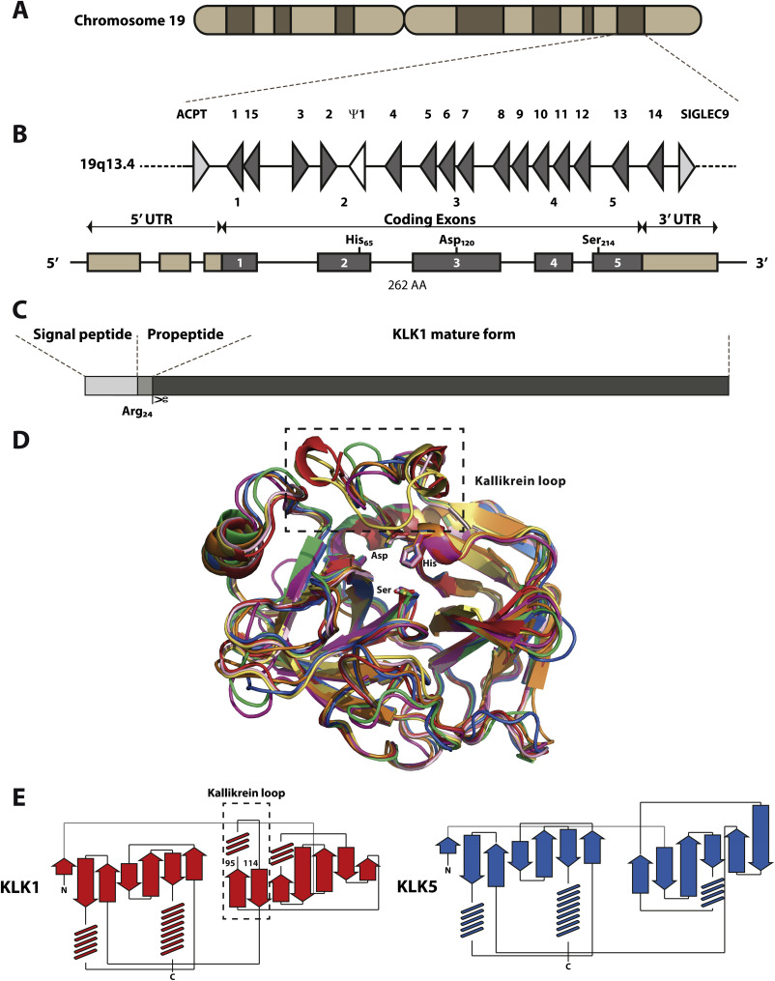
Introduction to kallikreins
Family of trypsin-like serine proteases
Cluster of 15 genes → Coexpressed
Expression regulated by steroid hormones
Secreted proteases
Involved in regulation of blood pressure, tissue remodelling, etc.
Kalinska et al. 2015
19.07.21
Project proposal – kallikrein gene
3

Slide 4
Role of kallikreins in cancer
Expression altered in hormone-related cancer
Up- and Downregulation
hK proteins promote or inhibit cacogenesis
Drug targets
Bio-markers
19.07.21
Project proposal – kallikrein gene
4

Slide 5
Cancer data sets
small cell lung cancer
GSE149507
breast
cancer
GSE65216
primary
breast cancer
GSE27830
6 patients:
-> carcinoma tissue
-> normal tissue
=> 12 samples
=> 20 samples
Her2, LumA, LumB, TNBC
=> 10 samples
Cai et al. 2021
Maire et al. 2013
Nagel et al. 2012
19.07.21
Project proposal – kallikrein gene
5

Slide 6
Cancer data sets
small cell lung cancer
GSE149507
breast
cancer
GSE65216
primary
breast cancer
GSE27830
6 patients:
-> carcinoma tissue
-> normal tissue
=> 12 samples
=> 20 samples
=> 10 samples
overall 73 unique KLK transcripts
TRAs: 27 KLK transcripts
Cai et al. 2021
Maire et al. 2013
Nagel et al. 2012
19.07.21
Project proposal – kallikrein gene
6

Slide 7
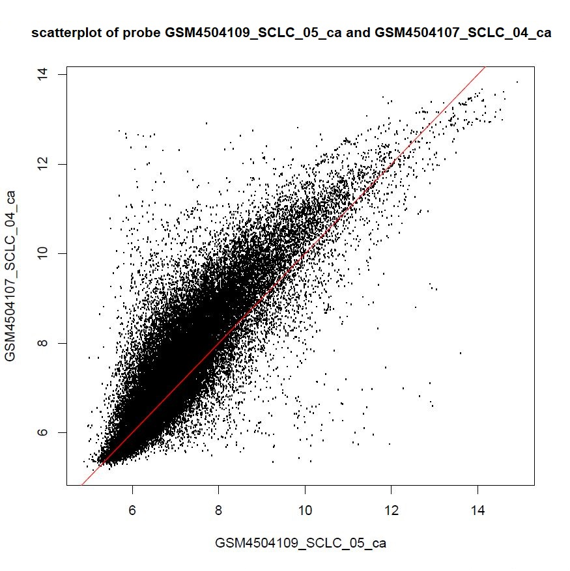
Quality control
lung cancer data set:
-> broken chip
19.07.21
Project proposal – kallikrein gene
7

Slide 8
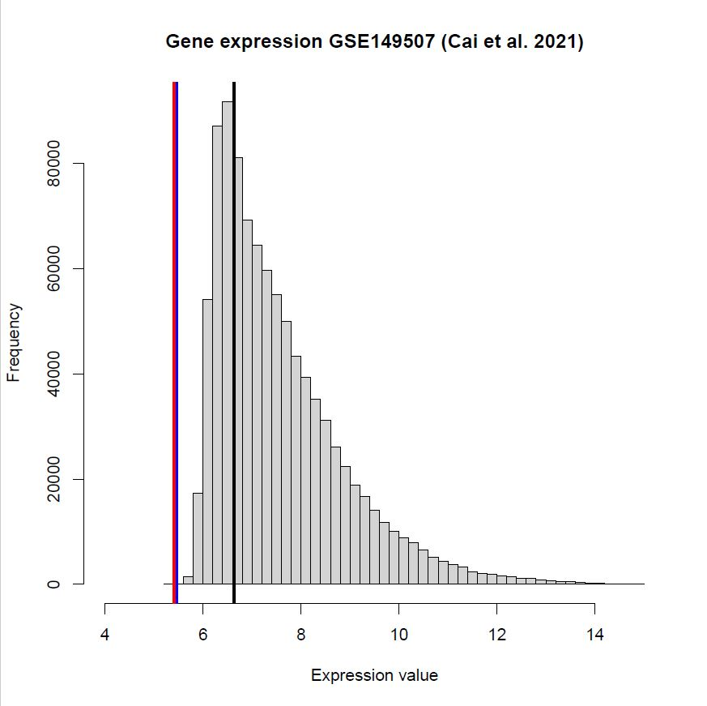
Small cell lung cancer
Black: Median all genes
Blue: Median all KLKs
Red: Median TRA KLKs
Log2 gene expression value
Low expression of (TRA) KLKs
19.07.21
Project proposal – kallikrein gene

Slide 9
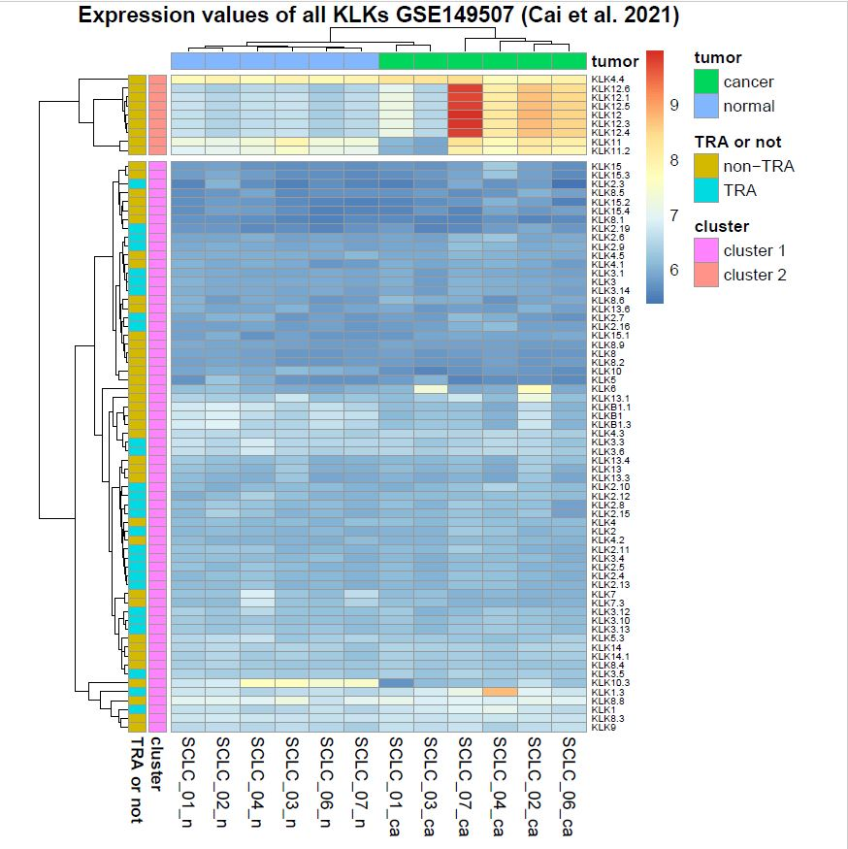
Exploratory analysis
samples
19.07.21
Project proposal – kallikrein gene
9

Slide 10
Exploratory analysis
Cluster
→ starting point
for further analysis
samples
19.07.21
Project proposal – kallikrein gene
10

Slide 11

Main goal
-> which kallikrein genes are TRAs?
-> gene expression clusters specific for cancer type?
-> target for cancer therapy?

Slide 12
Milestones
MILESTONE 01
MILESTONE 03
Filter lung- , breast- and rawdataset for kallikrein genes and determine which of them are TRAs
PCA
K means
Provide statistical prove by testing for significance in obtained values from MS 02.
20.06.21
MILESTONE 02
29.05.21
Scan
Screening for expression patterns in datasets - KLKs, TRAs – PCA to determine most relevant genes in different entities.
30.06.21
T Test
19.07.21
Project proposal – kallikrein gene
12

Slide 13
Gantt Chart
Apr.
Mai
Juni
Juli
Milestone
15
16
17
18
19
20
21
22
23
24
25
26
27
28
Project start
21.04.2021
Exploratory analysis
Project proposal
12.05.2021
Scan
PCA & K means
Statistical test
Final presentation
19.07.21
Project proposal – kallikrein gene
13

Slide 14



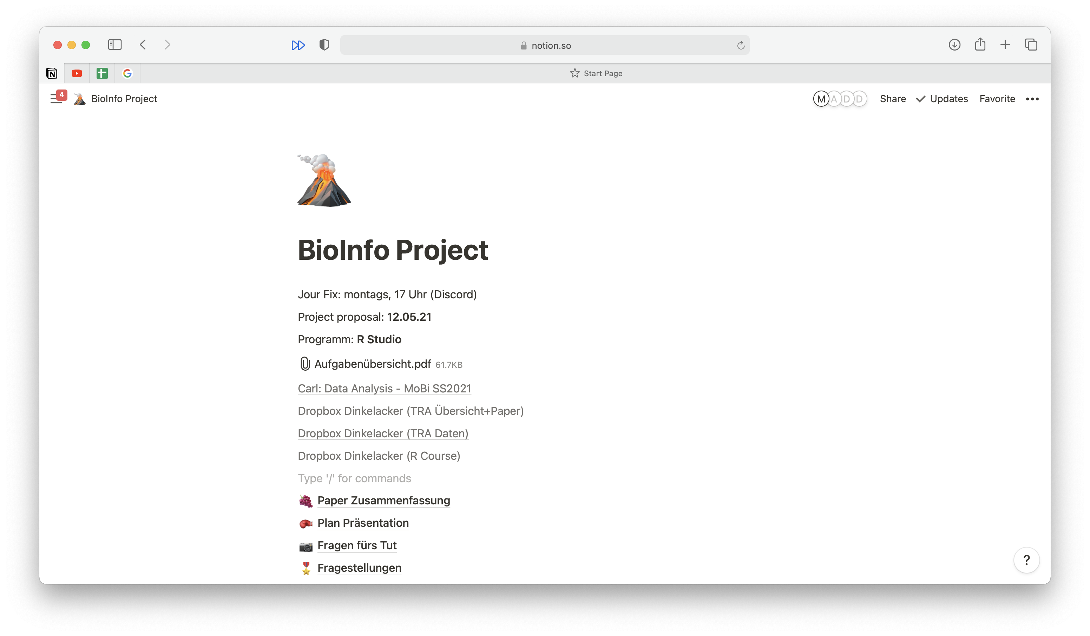


Teamwork aspect
Communication tool: WhatsApp
Project manangement tool: Notion
Jour Fix: monday, 5 pm
Debrief meeting after tutorial
Calls via Discord
19.07.21
Project proposal – kallikrein gene
14

Slide 15
Gantt Chart
Apr.
Mai
Juni
Juli
Milestone
15
16
17
18
19
20
21
22
23
24
25
26
27
28
Project start
21.04.2021
Exploratory Analysis
Project proposal
12.05.2021
Correlation Analysis
PCA
Regression Analysis
Final presentation
19.07.21
Project proposal – kallikrein gene
15

Slide 16
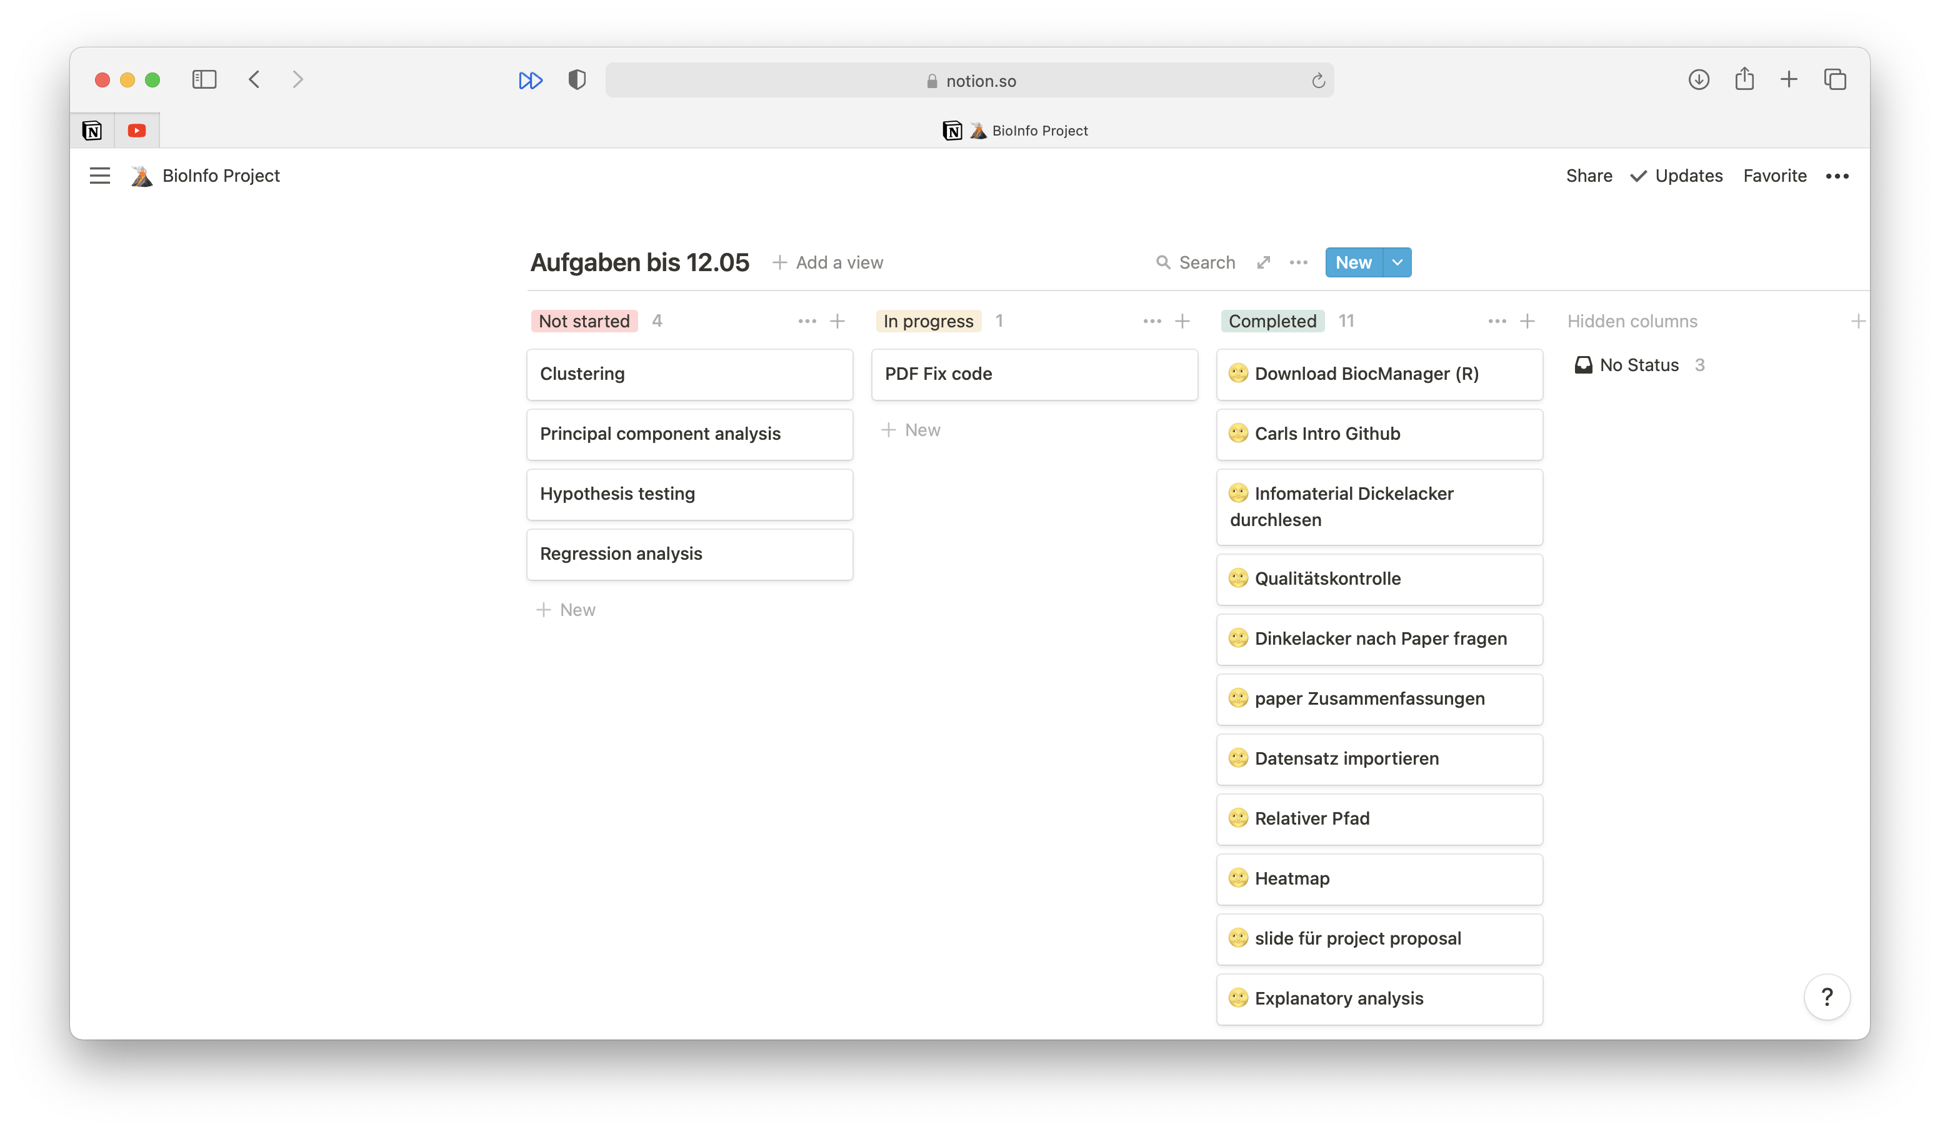
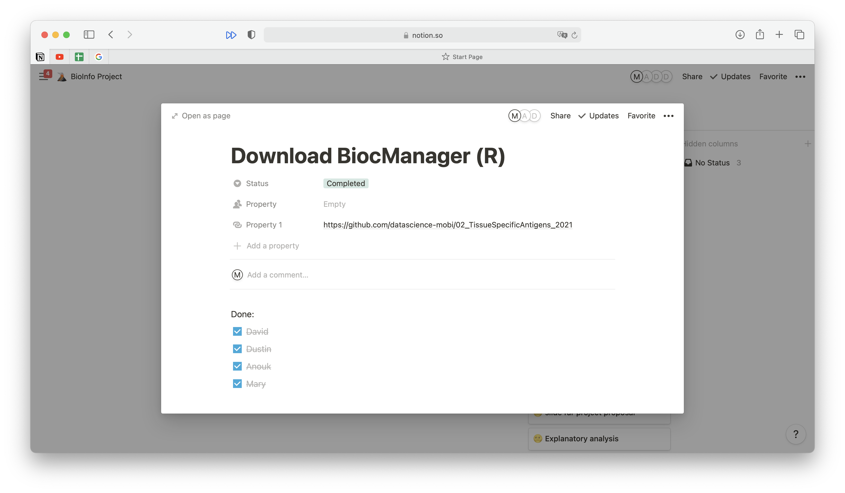
Project management tool
Kanban
19.07.21
Project proposal – kallikrein gene
16

Slide 17

Questions?
19.07.21
Project proposal – kallikrein gene
17

Slide 18
Literature
Cai et al., 2021: Cell-autonomous immune gene expression is repressed in pulmonary neuroendocrine cells and small cell lung cancer.
Maire et al., 2013: Polo-like kinase 1: a potential therapeutic option in combination with conventional chemotherapy for the management of patients with triple-negative breast cancer.
Nagel et al., 2012: Gene expression profiling assigns CHEK2 1100delC breast cancers to the luminal intrinsic subtypes.
19.07.21
Project proposal – kallikrein gene
18

Slide 20
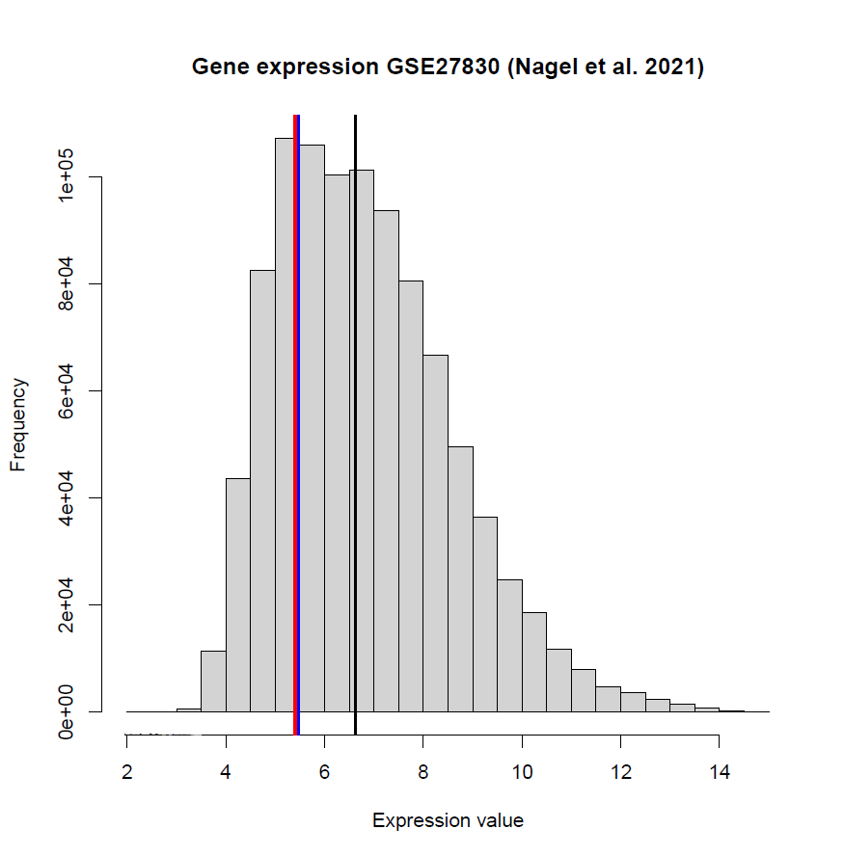

Slide 21
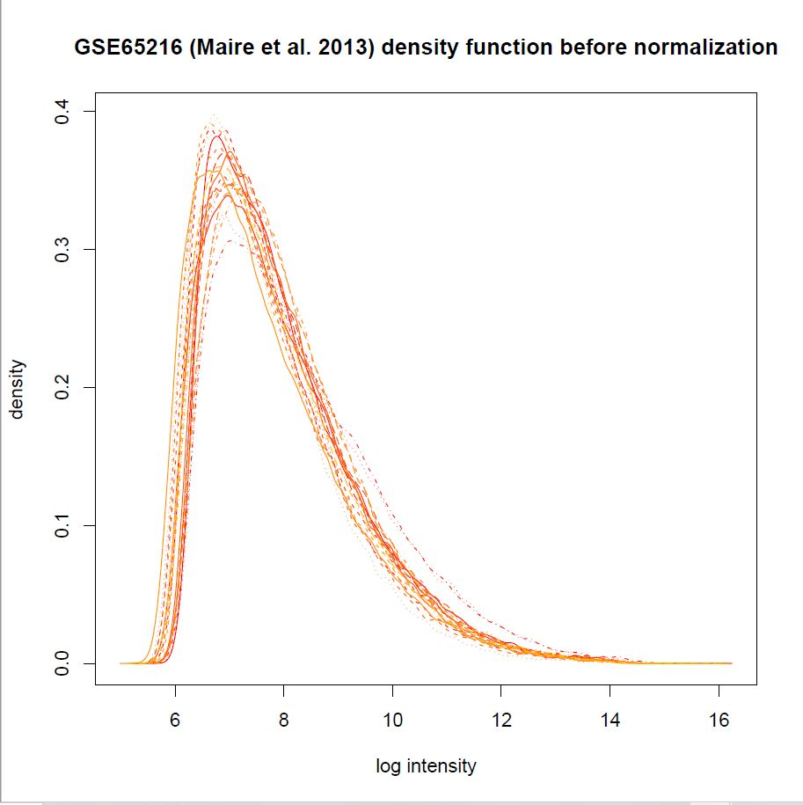
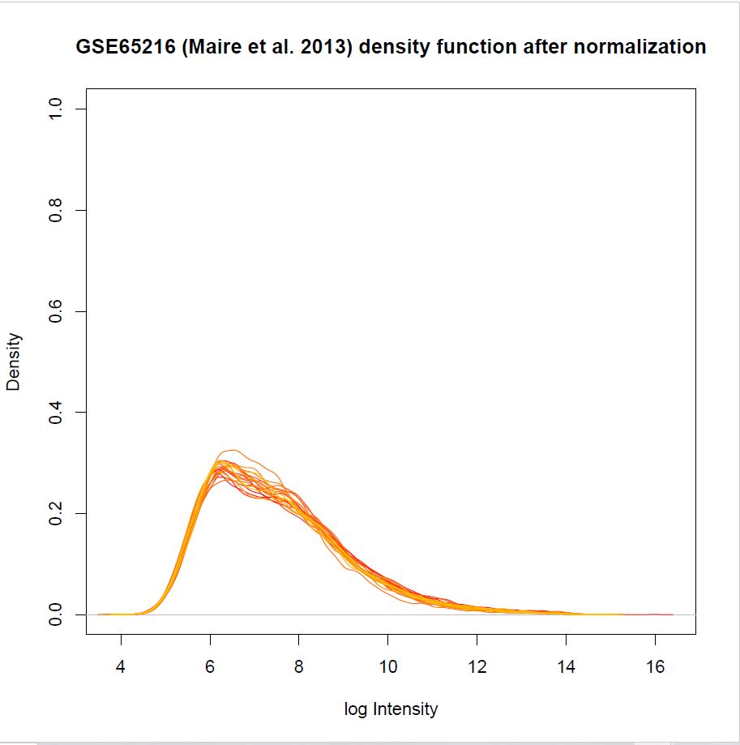

Slide 22
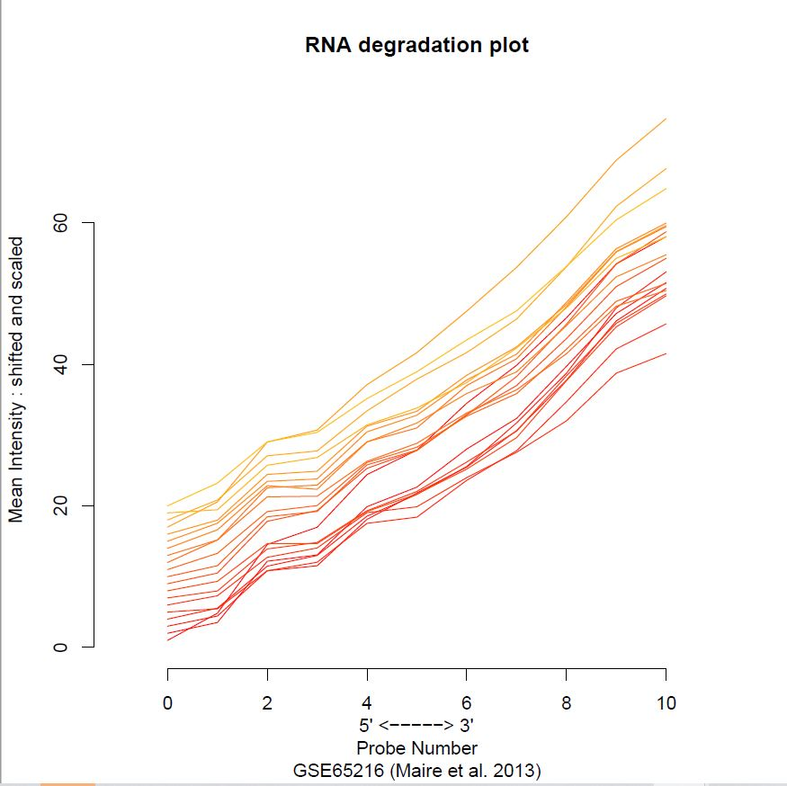
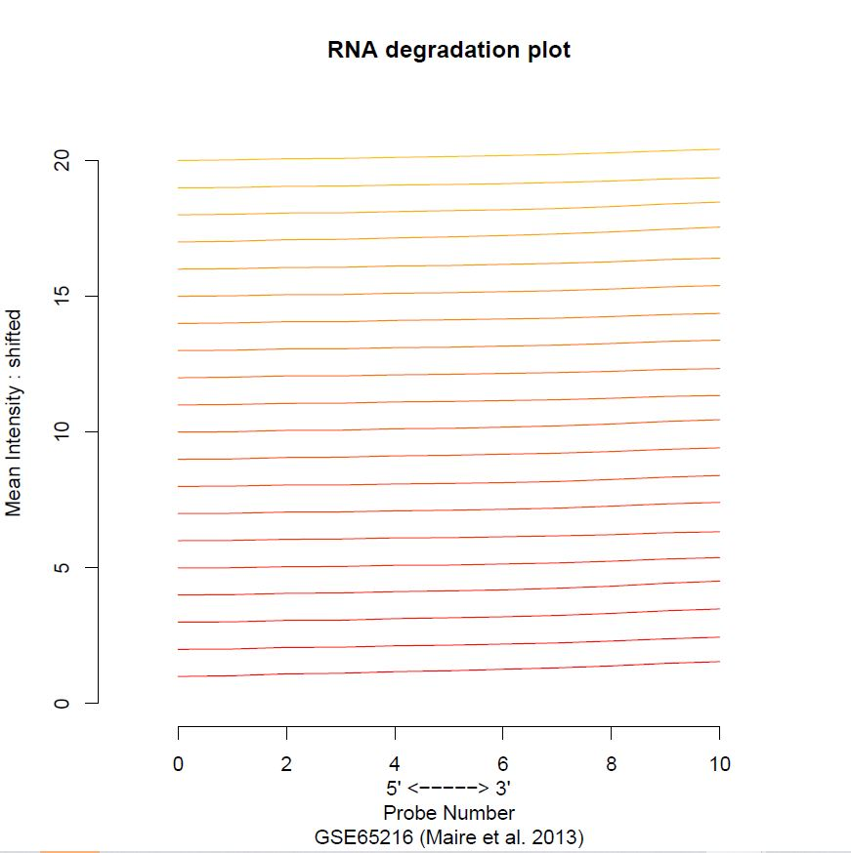

Slide 23
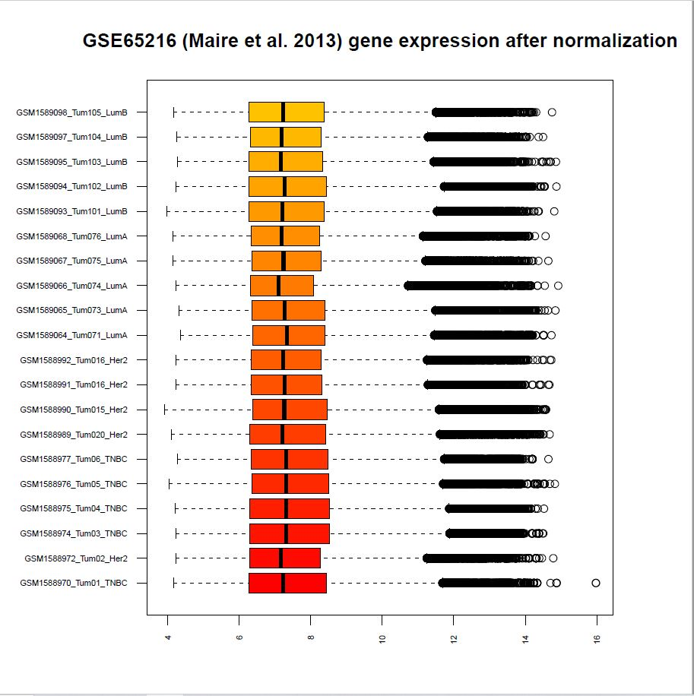
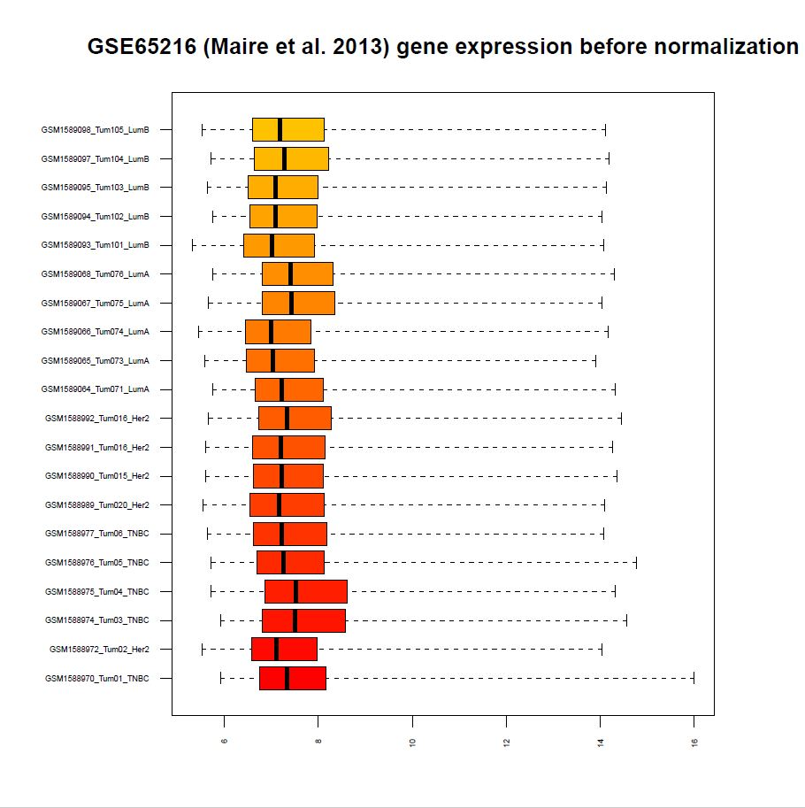

Slide 24
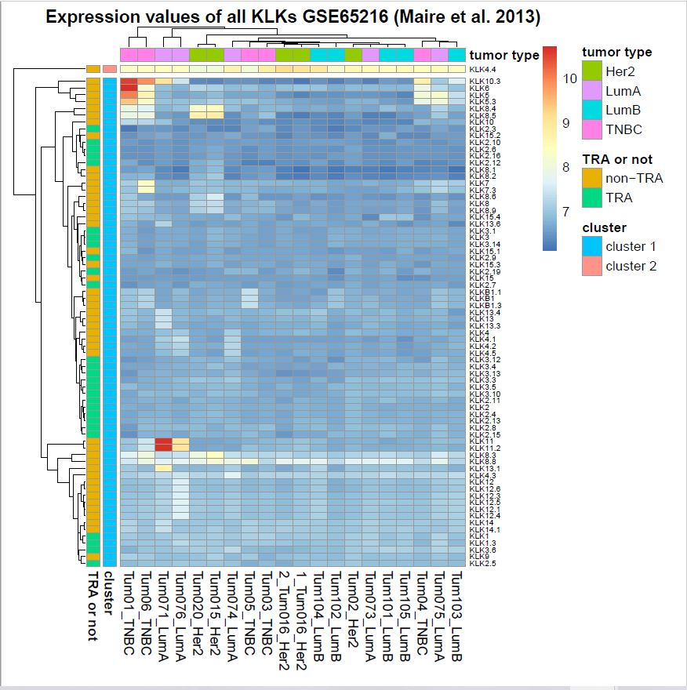

Slide 25
